Slide 1

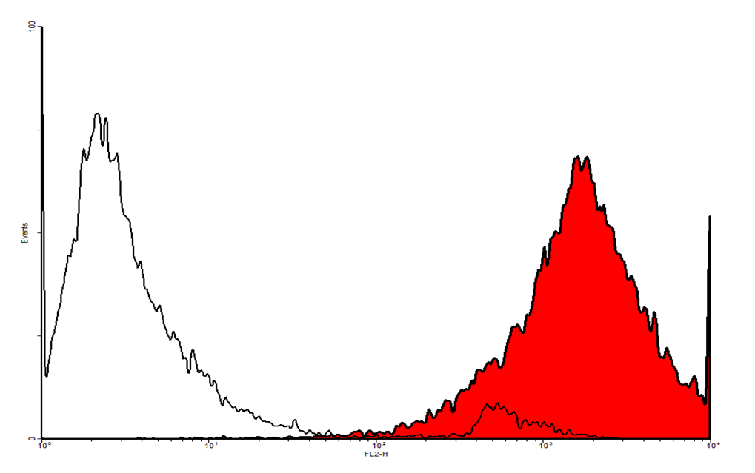
ReliaTech GmbH
Mouse anti-human Podoplanin
(Cat #101-M40)
Fig. 1: FACS analysis with primary human dermal lymphatic endothelial cells (HDLEC) using a PE-conjugated secondary antibody.
http://www.reliatech.de / orders@reliatech.de

